Slide 1
Identifying animals in camera trap footage
Project Update - Final Milestone
by Lena Schwertmann
Module: Machine Learning Lab
Examiner: Prof. Ulf Brefeld
Date: January 26, 2020
Notes:
→ large-scale camera trap projects create millions of images that are usually manually annotated!
→ automating animal detection is desirable…
… to free up resources for biologists or scale up their studies!

Slide 2

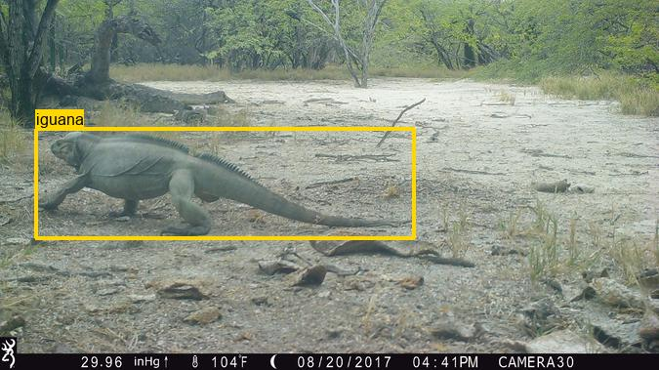
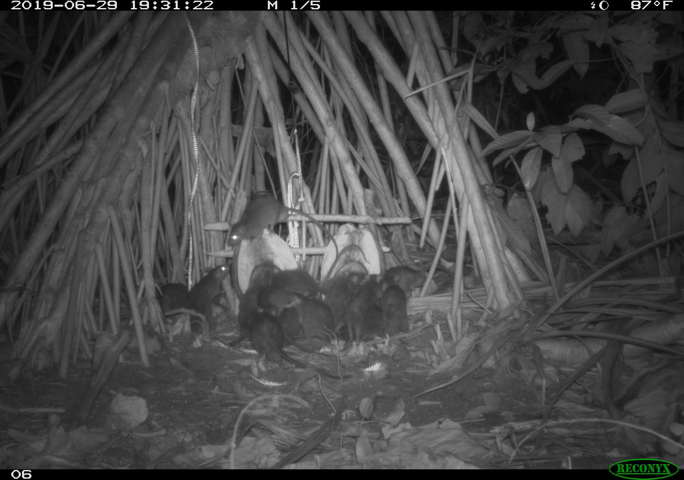
Data
dataset: Island Conservation Dataset (Pacific Ocean & Caribbean)
→ 100 k RGB images, 47 classes, imbalanced
only included images with a single animal (5k images excluded)
challenges
animals are often only partly visible
many different landscape types/backgrounds
Notes:
7 islands in 6 countries
10 CLASSES: LAST CLASS HAS 2000 IMAGES
6 CLASSES: LAST CLASS HAS 6000 IMAGES

Slide 3

Baseline & Model
Baseline: predict majority class
Baseline accuracy = 25% (5 classes, balanced)
Image Preprocessing
random crop to smallest image size (1280 x 1024 px)
transform to tensor
normalizing
Model: Fine-tuning pre-trained ResNet-18
5k image subset: 5 most frequent classes à 1000 images
→ empty, rat, rabbit, petrel, iguana
batch size: 64
loss function: cross entropy
learning rates: 0.1, 0.01
50 epochs
Methods: PyTorch + CUDA + university cluster
Notes:
FINE-TUNING = ONLY THE WEIGHTS IN THE LAST FULLY CONNECTED LAYER ARE CHANGED
→ interesting how good this can be and large speed benefits!

Slide 4
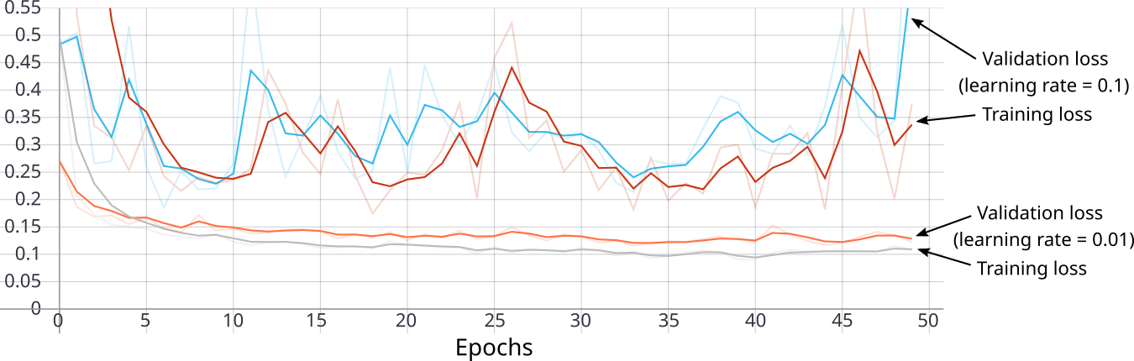
First results - loss
Notes:
2 runs on the university cluster, 50 epochs take 4 hours

Slide 5
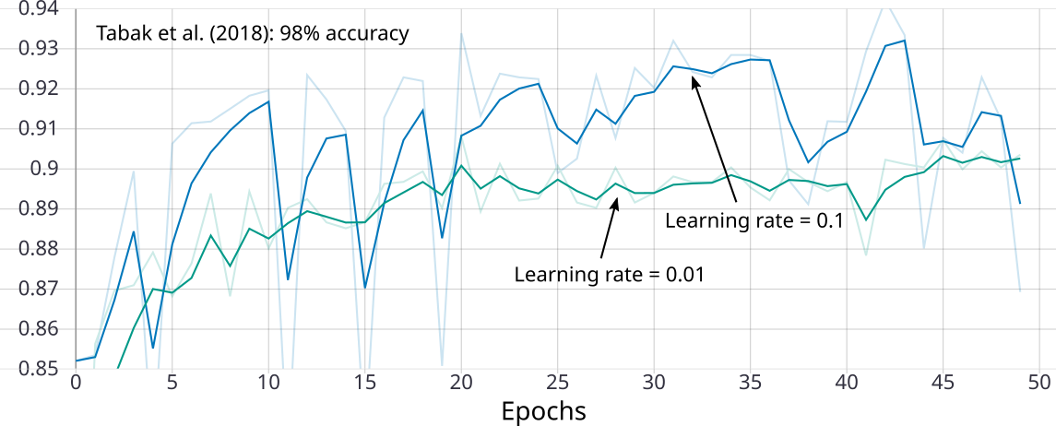
First results - mean accuracy

Slide 6
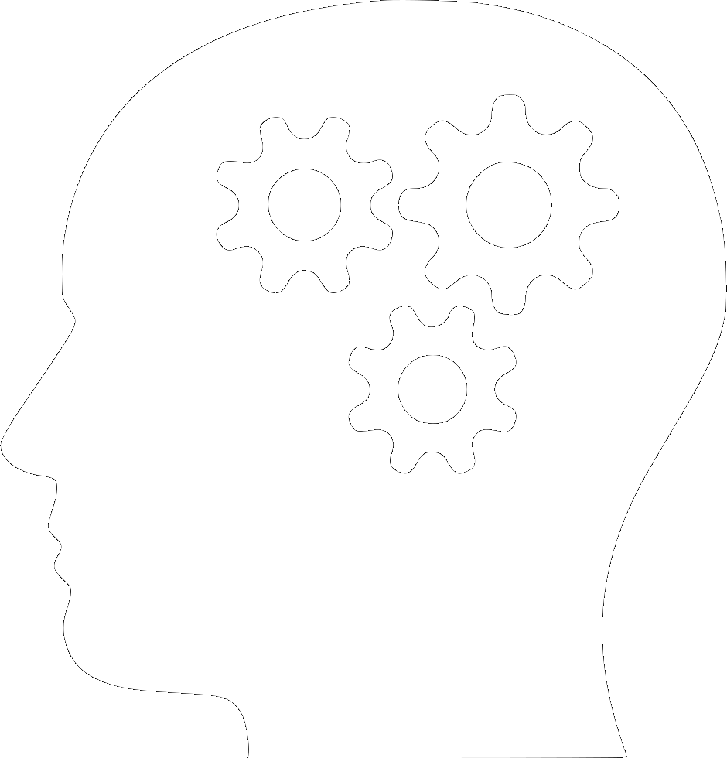
Outlook
Find optimal learning rate
Large balanced dataset (5 classes à 5k images = 25k)
Large imbalanced dataset (full top-5 classes = 100k images)
If computationally possible, train full model.
If possible, understand misclassified samples
→ Why are they hard to classify correctly?

